Slide 1
Computational Thinking, Problem Solving, and Programming
TOPIC 4.0 – Computational thinking
TOPIC 4
4.3.1 – 4.3.8: Coding Fundamentals

Slide 2

REVIEW REVIEW REVIEW REVIEW REVIEW REVIEW
THE WARM-UP QUESTION
What’s the BigO of this algorithm?
def insertion_sort(array, size):
for i in range(1, size):
key = array[i]
j = i
while (j > 0) and (array[j-1] > key):
array[j] = array[j-1]
j = j-1
array[j] = key

Slide 3
REVIEW REVIEW REVIEW REVIEW REVIEW REVIEW
THE WARM-UP ANSWER
O(n²) because there’s a loop inside of a loop
Nested loops

Slide 4
TOPIC 4.3.1 – INTRO TO PROGRAMMING
FUNDAMENTAL OPERATIONS
Adding numbers
Comparing information
Storing data
Retrieving data
Usually have specific hardware on the computer to do them
More complex operations are simply a combination of these fundamental operations

Slide 5
TOPIC 4.3.2 – INTRO TO PROGRAMMING
cOMPOUND OPERATIONS
We can combine fundamental operations to do more things
To get the max of three numbers:
MAX = A
if B > MAX then
MAX = B
end if
if C > MAX then
MAX = C
end if
output MAX

Slide 6
TOPIC 4.3.2 – INTRO TO PROGRAMMING
cOMPOUND OPERATIONS
MAX = A
if B > MAX then
MAX = B
end if
if C > MAX then
MAX = C
end if
output MAX
Comprised of
Two comparisons
Up to three data stores
Three data retrievals

Slide 7
TOPIC 4.3.3 – INTRO TO PROGRAMMING
COMPUTER LANGUAGE FEATURES
Each programming language has its own semantics
Semantics refers to what’s possible to construct in the language
Syntax describes the structure of the language, where the language’s grammar defines that structure
Grammar defines syntax
High level languages reserve keywords for use in syntax
for, if, else, def, import, etc.
Makes programs unambiguous

Slide 8
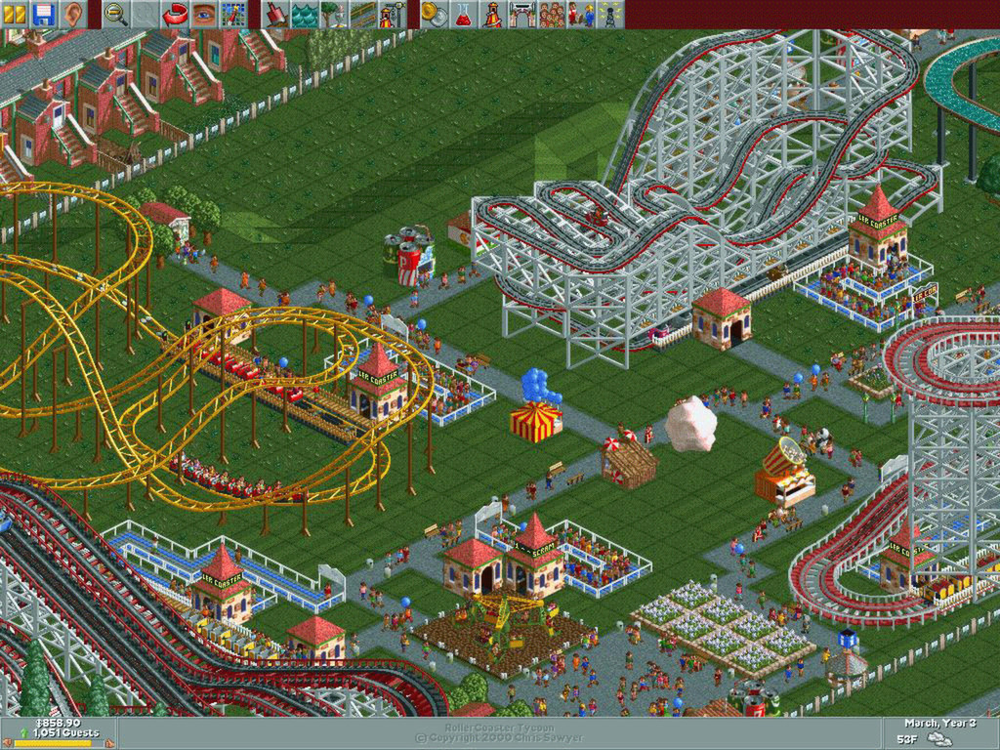
TOPIC 4.3.4 – INTRO TO PROGRAMMING
HIGH LEVEL LANGUAGES
High level languages abstract the inner workings of the computer
Computers run code in machine language, which is different for every computer.
First programming languages are instructions directly for the CPU, and directly mapped to binary operations
Assembly language.
Rollercoaster Tycoon was written entirely in x86 Assembly

Slide 9
TOPIC 4.3.4 – INTRO TO PROGRAMMING
HIGH LEVEL LANGUAGES
Assembly is converted to binary code by an assembler.
High level languages were developed that convert to assembly, which then converts to binary
High level includes Python, Java, C++, C#, JavaScript
High level languages use words that humans can understand (mostly)
Words in order humans can understand
Raw computer hardware like memory and disk use is obfuscated
Simpler to code, faster to code, easier to read and understand

Slide 10
TOPIC 4.3.5 – INTRO TO PROGRAMMING
HIGH LEVEL LANGUAGES
We know high level code must be converted to low level code to run
How do we do this?
Two different kinds of high level languages:
Compiled
Interpreted

Slide 11
TOPIC 4.3.5 – INTRO TO PROGRAMMING
Compiled languages
Compiled languages translate your code into machine code
Process called compilation
Whole program is saved, and when anybody runs the program it runs the machine code, not your high level code.
Very fast, as it doesn’t have to compile more than once
Takes up extra space for compiled program
Example: Java converts a .java file of java code into a .class file of low-level code, same with C++, C#

Slide 12
TOPIC 4.3.5 – INTRO TO PROGRAMMING
Interpreted languages
Interpreted languages translate the program every time they run
No need to convert ahead of time and run afterwards
Each time it runs, it converts in real time, line by line
Much more time consuming
Examples: BASIC, Python

Slide 13
TOPIC 4.3.6 – INTRO TO PROGRAMMING
Structure of language
Variables: store data in program, data can be changed.
Has a name and a type
Python automatically changes the type if need be
Name of variable should indicate what data it stores
Constant: non-modifiable variables
Operator: manipulate operands
+, -, *, /, %, and, or, not
Object: comprised of data variables and procedures
Usually intended to abstract the real world

Slide 14
TOPIC 4.3.7 – INTRO TO PROGRAMMING
Operators
= - assign a variable
== - equals
!= - not equals
> - greater than
< - less than
>= - greater than or equal to
<= - less than or equal to
div – integer part of quotient (integer division)
mod – remainder of integer division (modulo)

Slide 15
TOPIC 4.3.7 – INTRO TO PROGRAMMING
DIV
Div isn’t just divide
print(5/2) #2.5
print(5//2) #2
Div is the ‘ib-pseudocode’ approved way of doing ‘floor division’ in Python

Slide 16
TOPIC 4.3.7 – INTRO TO PROGRAMMING
MOD
Mod gets the remainder of the statement
print(5%2) #1
In ‘ib-pseudocode’ terms, we replace the % with the word mod written out

Slide 17
TOPIC 4.3.7 – INTRO TO PROGRAMMING
MOD + Div
Can be used to get the digit in each place of a number
num = int(input(“enter a number”))
ones = num%10
tens = (num // 10)%10
hundreds = (num//100)%10
…
Same logic could help us get change for a cash register

Slide 18
TOPIC 4.3.8 – INTRO TO PROGRAMMING
constants
Constant variables cannot be altered once the program has begun
Python doesn’t support creating constant variables
If you have one you don’t want to change, name it in ALL_CAPS
Constants are useful for values that don’t change mid program
Examples: Pi, e (Natural log), c (speed of light), gravity, etc.

Slide 19
TOPIC 4.3.8 – INTRO TO PROGRAMMING
constants
Program to calculate area of circle and volume of cylinder
PI = 3.1415926535 #constant pi
def calculateCircleArea(radius):
return PI * (radius ** 2)
def calculateCylinderVolume(radius, height):
return height * PI * (radius ** 2)
print(calculateCircleArea(2))
print(calculateCylinderVolume(5, 4))

Slide 20
TOPIC 4.3.8 – INTRO TO PROGRAMMING
Local vs global
Local Variables
Declared within a procedure
Only accessible within that procedure
Global Variables
Declared for entire program
Accessible from anywhere within that program

Slide 21
TOPIC 4.3.8 – INTRO TO PROGRAMMING
VARIABLE SCOPE
w = 7
def procedureName():
x = 10
if x >= 10:
y = 5
while y > 0:
y -= 1
x -= 3
z = 5
return x
print (procedureName())
At what points are the variables w, x, y, and z able to be accessed?
What if I tried to access z in the if statement?
What if I tried to access x in the main code segment?

Slide 22
TOPIC 4.3.8 – INTRO TO PROGRAMMING
VARIABLE SCOPE
Scope refers to where the variable is created/is accessible
Variables are accessible in fields contained within the field the variable was created in
A variable cannot be accessed in a ‘larger’ scope than the one it was created in

Slide 23
TOPIC 4.3.8 – INTRO TO PROGRAMMING
VARIABLE SCOPE
Think of our if statements, loops, and procedures as folders inside of folders
Variables are accessible in the smaller folders in their folder, but not the ones above them

Slide 24
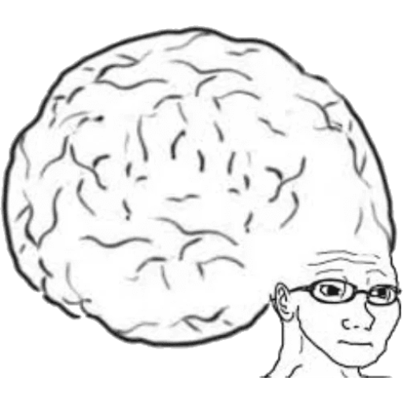
TOPIC 4.2.1 – THINKING Logically
Vocab to remember
Variable
Constant
Scope
Local Variable
Global Variable
Mod
High Level Language

